Slide 1
Cost Optimization Fundamental Pricing for Compute, Storage, Data Transfer: Key Considerations

Slide 2

Agenda
AWS Pricing Key Principles
AWS Pricing Models
AWS Pricing Calculator
Ways to Reduce AWS Bill
AWS Cost Optimization
Demo: Pricing Calculator/Estimates
Q&A
Notes:
Time: 1 mins.

Slide 3
AWS Pricing Key Principles

Slide 4

Pricing Key Principles
Understand the fundamentals of pricing
There are three fundamental drivers of cost with AWS: compute, storage, and outbound data transfer.
Start early with cost optimization
Trade fixed expenses (such as data centers and physical servers) for variable expenses, and only pay for IT as you consume it.
Maximize the power of flexibility
AWS services are priced independently, transparently, and available on-demand, so you can choose and pay for exactly what you need.
Use the right pricing model for the job
On-Demand Instances, Savings Plans, Spot Instances, Reservations
© 2021, Amazon Web Services, Inc. or its affiliates. All rights reserved.
Notes:
Time: 1 - 2 mins.

Slide 5
AWS Pricing Models

Slide 6
Comparing Pricing by Instance Type
On Demand | Reserved | Spot
Users that prefer the low cost and flexibility of Amazon EC2 without any up-front payment or long-term commitment. | Applications with Steady State Usage With Reserved Instances, you can save up to 72% over equivalent on-demand capacity. | Applications that have flexible start and end times.
Applications with short-term, spiky, or unpredictable workloads that cannot be interrupted. | Applications that may require reserved capacity. | Applications that are only feasible at very low compute prices.
Applications being developed or tested on Amazon EC2 for the first time. | Customers that can commit to use EC2 instances for 1-to-3-year term to reduce their total computing cost. | Users with urgent computing needs for large amounts of additional capacity.
© 2021, Amazon Web Services, Inc. or its affiliates. All rights reserved.
Notes:
Time: 1 - 2 mins.

Slide 7
Comparing Pricing by Service
Pay per hour used based on size provisioned
EC2, RDS
Pay per hour used based on size and quantity used
S3, EFS, Lambda
On-Demand pay per use
All Services
Reserved (Commitment discount)
EC2, RDS, Redshift, ElasticCache, DynamoDB
Spot (Spare Capacity Discount)
EC2
© 2021, Amazon Web Services, Inc. or its affiliates. All rights reserved.
Notes:
Time: 1 - 2 mins.

Slide 8
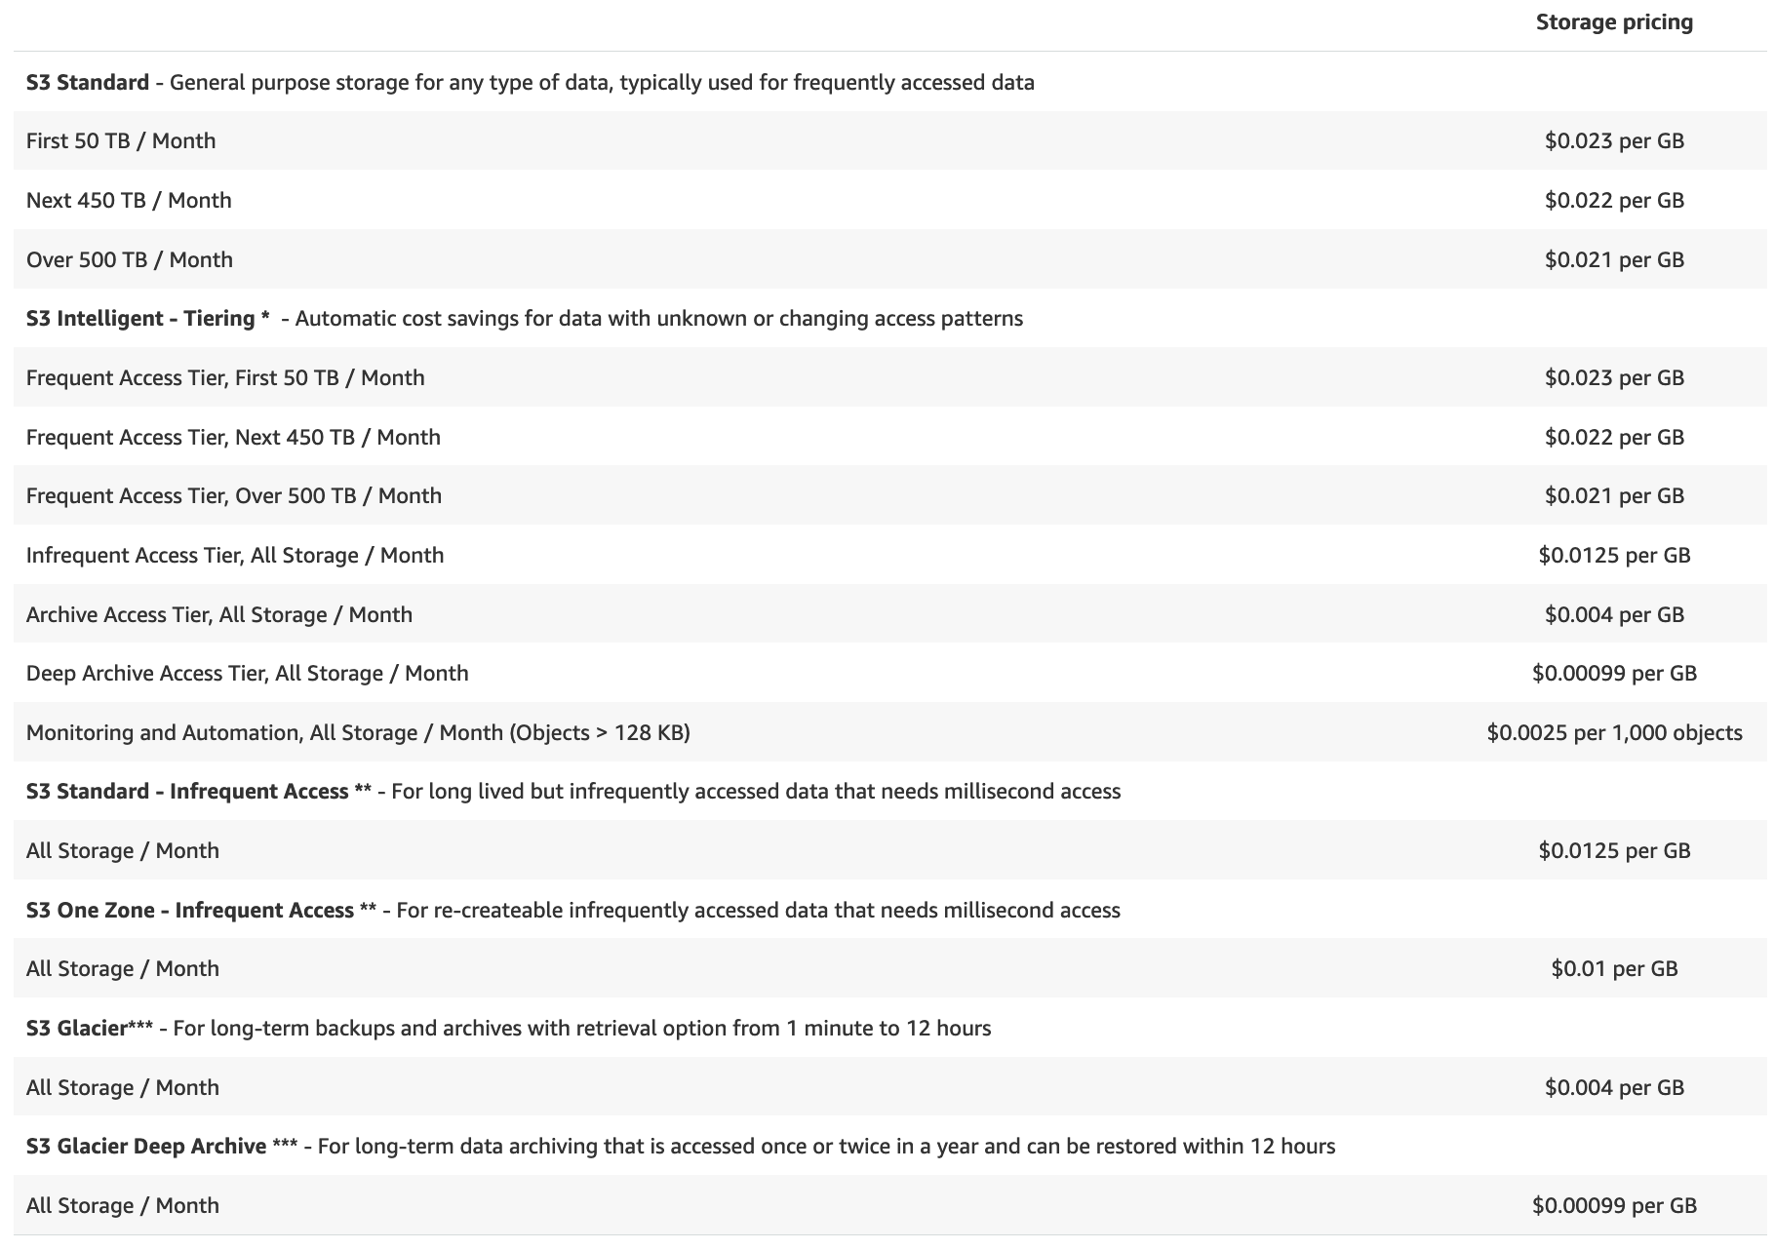
AWS Pricing Models for S3
© 2021, Amazon Web Services, Inc. or its affiliates. All rights reserved.
Notes:
Time: 1 - 2 mins.

Slide 9
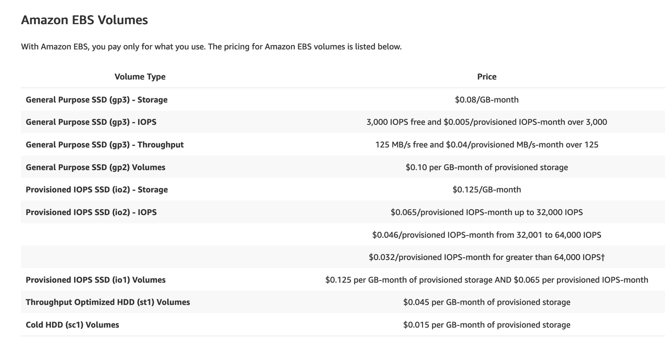
AWS Pricing Models for EBS
© 2021, Amazon Web Services, Inc. or its affiliates. All rights reserved.
Notes:
Time: 1 - 2 mins.

Slide 10
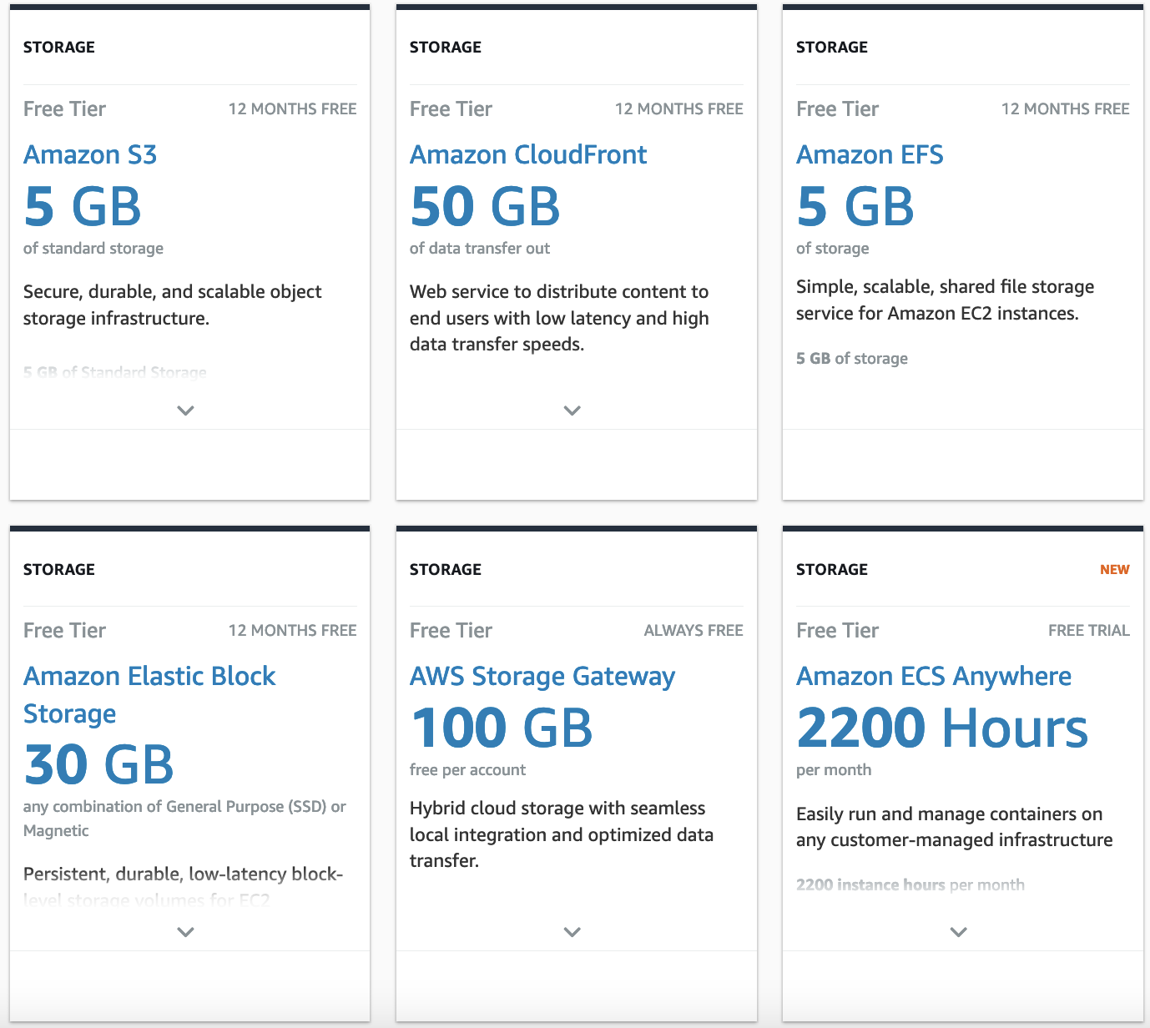
AWS Pricing Models for Storage (Free Tier)
© 2021, Amazon Web Services, Inc. or its affiliates. All rights reserved.
Notes:
Time: 1 - 2 mins.

Slide 11
AWS Pricing Calculator

Slide 12
What is AWS Pricing Calculator?
Transparent Pricing
Share your estimates
Hierarchical estimates
Estimate exports
Benefits and Features
Reduce your Amazon EC2 spend
Find the right Amazon EC2 Instance
Estimate your AWS spend
Compare service costs per Region
Use Cases
© 2021, Amazon Web Services, Inc. or its affiliates. All rights reserved.
Notes:
Time: 1 - 2 mins.

Slide 13
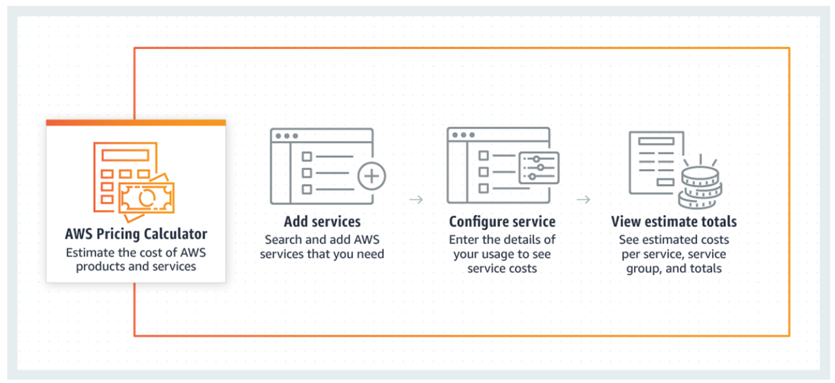
How it works?
© 2021, Amazon Web Services, Inc. or its affiliates. All rights reserved.
Notes:
Time: 1 - 2 mins.

Slide 14
Ways to Reduce AWS Bill

Slide 15
Different Ways to Reduce your AWS Bill
Identify Amazon EC2 instances with low-utilization and reduce cost by stopping or rightsizing
Identify Amazon EBS volumes with low-utilization and reduce cost by snapshotting then deleting them
Analyze Amazon S3 usage and reduce cost by leveraging lower cost storage tiers
Identify Amazon RDS, Amazon Redshift instances with low utilization and reduce cost by stopping (RDS) and pausing (Redshift)
Analyze Amazon DynamoDB usage and reduce cost by leveraging Autoscaling or On-demand
Review networking and reduce costs by deleting idle load balancers
Use Amazon EC2 Spot Instances to reduce EC2 costs
Review and modify EC2 AutoScaling Groups configuration
Use Reserved Instances (RI) to reduce RDS, Redshift, ElastiCache and Elasticsearch costs
Use Compute Savings Plans to reduce EC2, Fargate and Lambda costs
© 2021, Amazon Web Services, Inc. or its affiliates. All rights reserved.
Notes:
Time: 1 - 2 mins.

Slide 16
AWS Cost Optimization

Slide 17
What is AWS Cost Optimization?
Choose the right pricing models
Match Capacity with Demand
Implement processes to identify resource waste
Use Reserved Instances (RI) to reduce Amazon RDS, Amazon Redshift, Amazon ElastiCache, and Amazon OpenSearch Service costs
Use Amazon Spot Instances to reduce EC2 costs or use Compute Savings Plan to reduce EC2, Fargate and Lambda cost.
Identify Amazon EC2 instances with low-utilization and reduce cost by stopping or rightsizing
Identify Amazon RDS, Amazon Redshift instances with low utilization and reduce cost by stopping (RDS) and pausing (Redshift)
Analyze Amazon DynamoDB usage and reduce cost by leveraging Autoscaling or On-demand
Identify Amazon EBS volumes with low-utilization and reduce cost by snapshotting then deleting them
Analyze Amazon S3 usage and reduce cost by leveraging lower cost storage tiers
Review networking and reduce costs by deleting idle load balancers
© 2021, Amazon Web Services, Inc. or its affiliates. All rights reserved.
Notes:
Time: 1 - 2 mins.

Slide 18
Demo: Pricing Calculator/Estimates

Slide 19
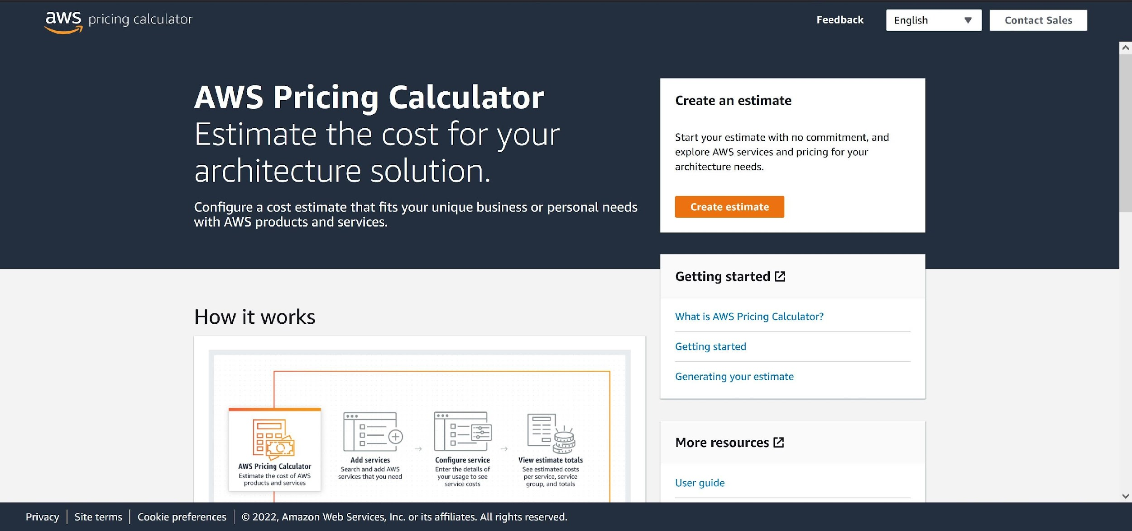
Notes:
Time: 15 - 20 mins.
Notes: (Do Not Need Sandbox Environment)
Create an estimate and show the Pricing Calculator is action. The AWS Pricing Calculator link: https://calculator.aws/#/

Slide 20
Q & A
Notes:
Time: 10 -15 mins.

